Slide 1
Rationale
Gerrit:
continuous integration pre-commit
automated workflow
Git:
tool of choice for distributed development teams
in the future, removes need for SVN/WANdisco costs on new programs
Gerrit/Jenkins/Git:
industry standard process
extensible framework
actively developed & well supported

Slide 2
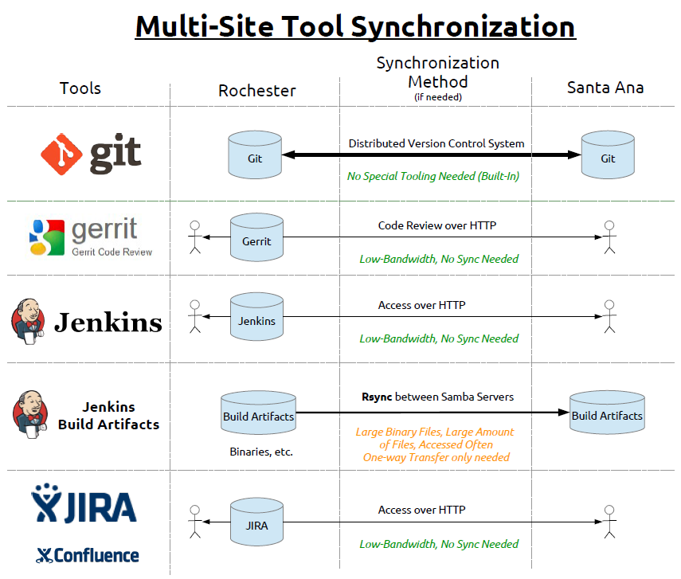

Slide 3
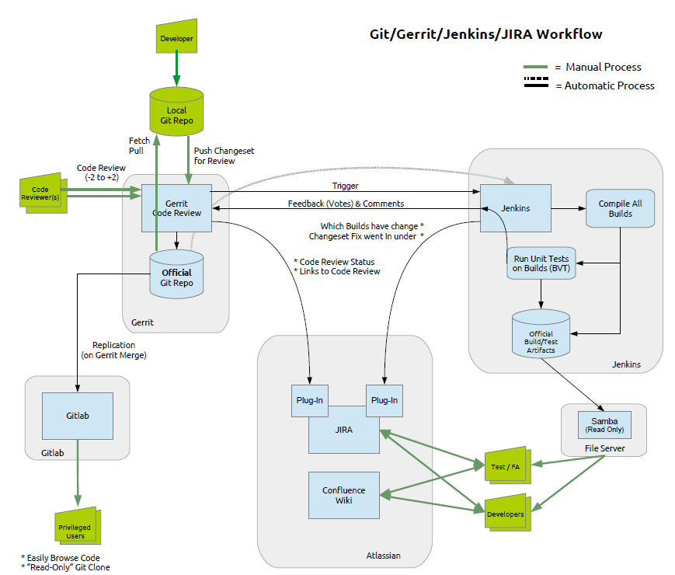

Slide 4
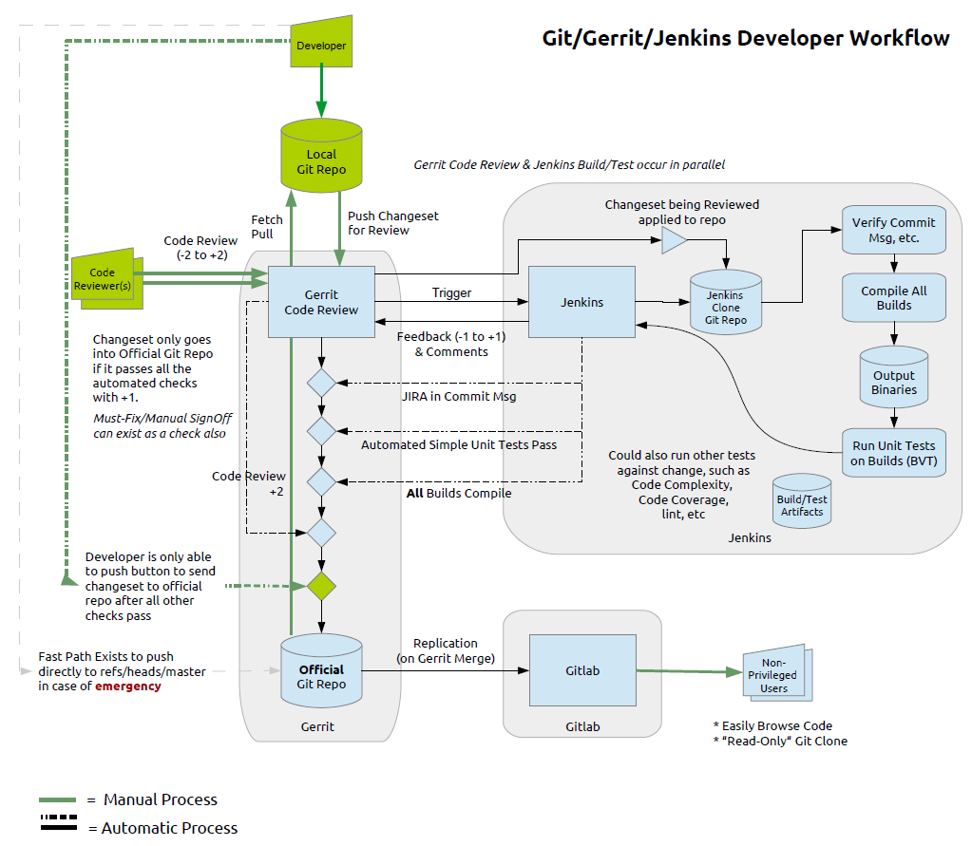
(add drawing)

Slide 5
